Slide 1

StayAPT Training Digital Key Fuel/Jonas Chorum
5/11/22

Slide 2
Who Can Use Digital Key
Any NON-OTA reservation
Must have a credit card on file, if payment code is CASH they will not be able to use Digital Key

Slide 3
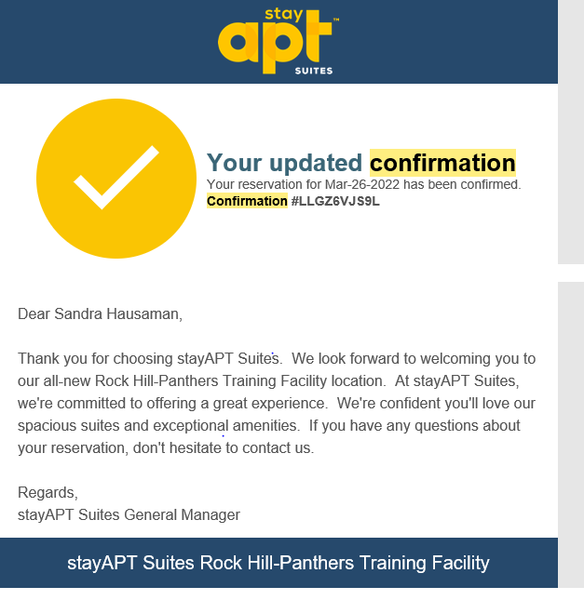
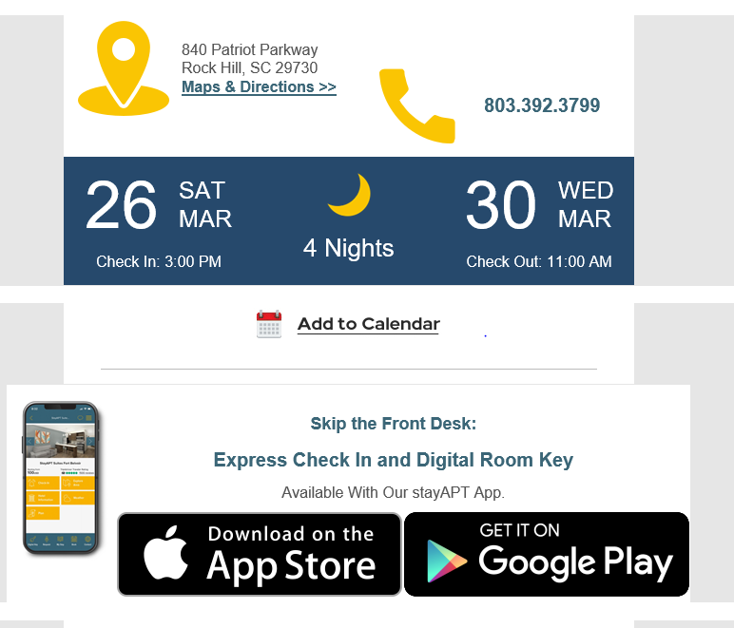
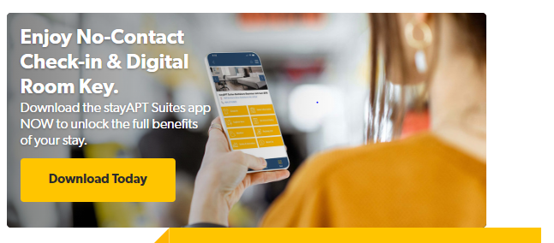
How do we communicate the app? Booking confirmation: Offers the download to the Digital Room Key Also prominent on the website

Slide 4
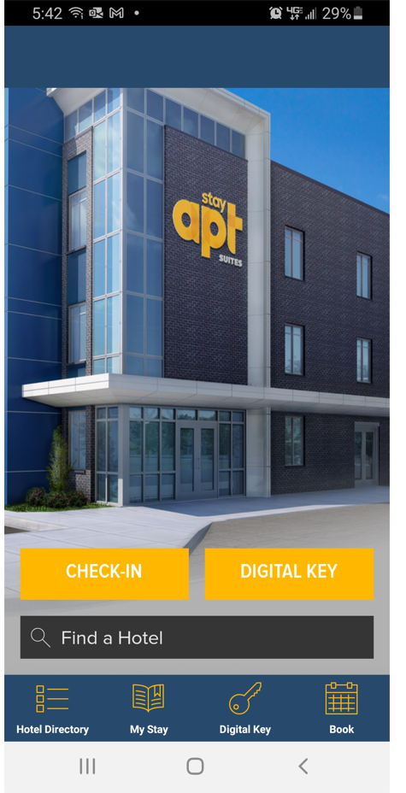
Once the Digital Key app has been downloaded and launched, this is the starting screen. The guest would then enter the location of the hotel

Slide 5
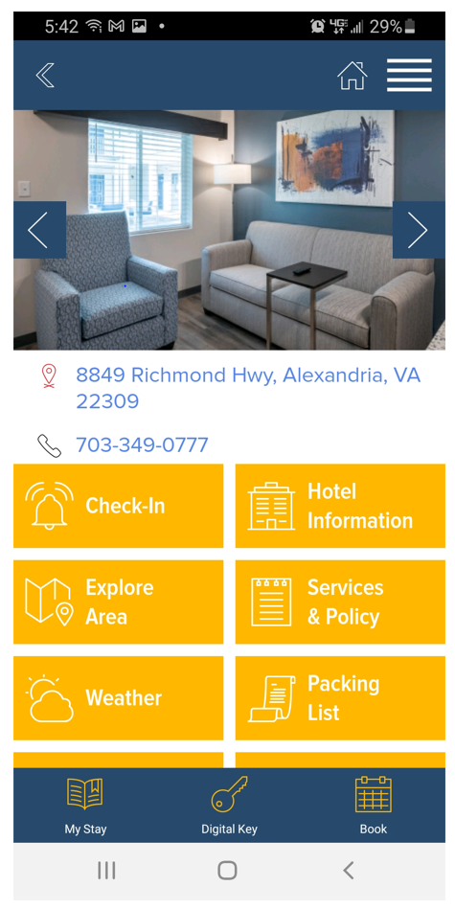
Guest now can choose whether they want to use the app to Check In or if they’ve already checked in, they can use the app to access Digital Key

Slide 6
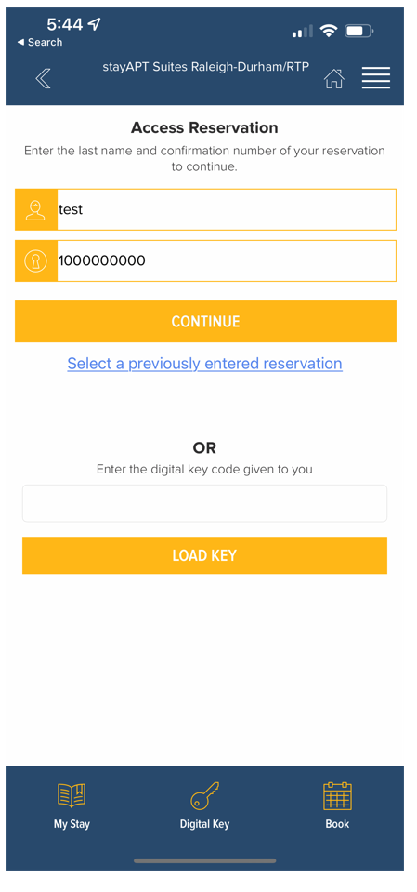
Step 1-Access Reservation
The guest will enter their name.
The guest will enter their confirmation number

Slide 7
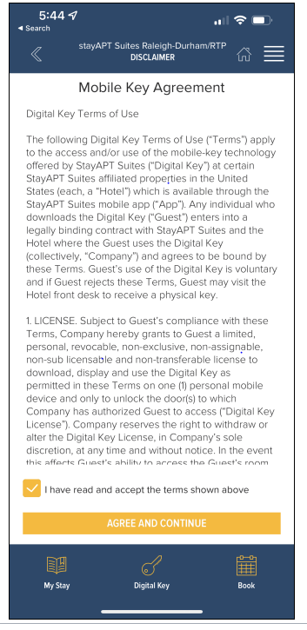
Step 2-Guest Agrees to Conditions
The Guest will Check that they’ve read and accept the terms.
Click agree and continue

Slide 8
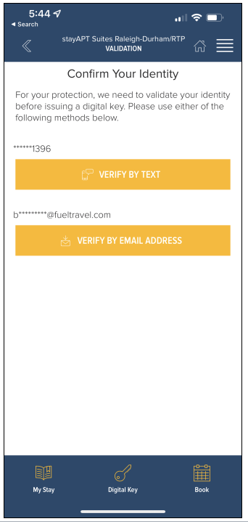
Step 3-Confirming the Guest Identity
Guest may choose to verify by Text or Email Address.

